Slide 1
Metaphors
Poetry Workshop

Slide 2
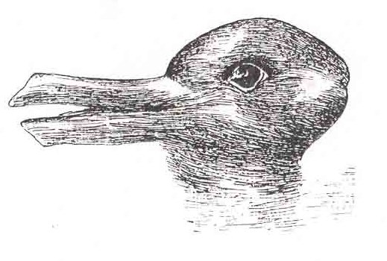
Perceptions I: What do you see?
Is it a duck…
…or a rabbit?
Notes:
Slides 2 – 4
This is a fun activity about changing perceptions.
Learners may be familiar with these images as they feature in a prominent psychological study.
They can use any previous knowledge to scaffold this task which will make it more light-hearted and fun.

Slide 3
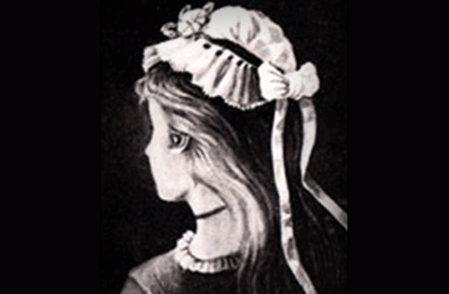
Perceptions I: What do you see?
Is it a young girl…
…or an old lady?

Slide 4
Perceptions I: What do you see?
Is it a donkey…
…or a seal?

Slide 5
Metaphors

Slide 6
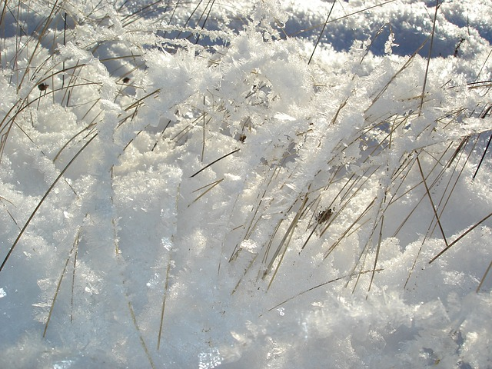
Perceptions II: What do you see?
A sunset
A bed of nails
Snow on grass
Microscopic hairs on a snowman’s arm
A rainbow
Notes:
Slides 6- 8
This activity first asks learners to choose a plain speech description from the left hand side of the image. Learners may work together to do this using any support deemed necessary.
The second part asks them to consider poetic language, i.e. the metaphor. Learners decode and choose the metaphor from the right hand side of the image they think is most effective and say why. Discuss this with the class.

Slide 7
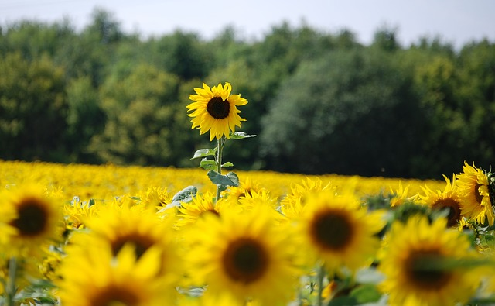
Perceptions I: What do you see?
A field of sunflowers
A tall man in the sun
A bed of roses
A sun chained to the earth
A wasteland

Slide 8
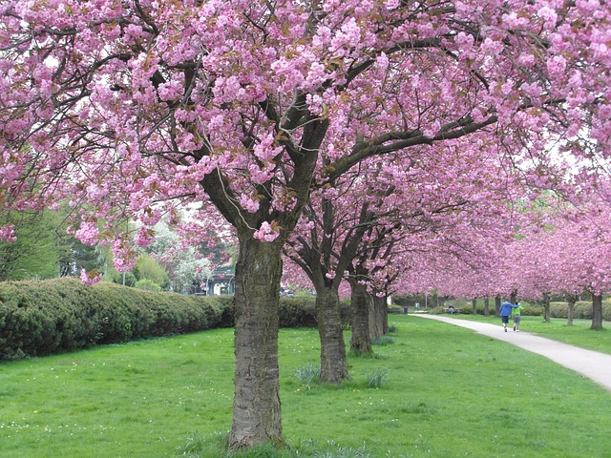
Perceptions I: What do you see?
Greenery
Life through rose-tinted spectacles
A pedestrian zone
A candyfloss sky
Cherry blossoms in bloom

Slide 9
My senses…
I see…
I hear…
I smell…
I taste…
I touch…
Notes:
Slides 9 – 12
Before learners compose their own “I am” poems, these slides ask them to work in groups completing the sentences from the perspective of the sunflower. (You may use any other image or object)
Learners may do this activity like a game of “Consequences” where one person writes a line then passes it on to the next person to complete the next line.
After each slide bring the class together and discuss what they have written. What interesting language has been used? What interesting perspectives did they think of?

Slide 10
My feelings and thoughts…
I think about…
I feel…
I know…
I imagine…

Slide 11
My hopes and fears…
I dream about…
I am frightened of…
I hope…

Slide 12
My desires…
I want…
I love…
I need…

Slide 13
Who am I?
I am _______________
I see_______________
I hear _________________
I smell __________________
I touch _______________
I am _______________
Notes:
Slides 13 – 15
Now bring the class together. Using a selection of sentences from each group compose a whole class “I am” poem based on the perspective of the sunflower (or other object).
You may decide which sentences to use by asking each group to write their responses on flipchart paper, sticking these to the board/wall and asking the class to put a tick next to their favourite sentences.

Slide 14
Who am I?
I imagine _______________
I know _______________
I feel _________________
I am frightened of__________________
I need _______________
I am _______________

Slide 15
Who am I?
I want _______________
I think about _______________
I dream about _________________
I love __________________
I hope _______________
I am _______________

Slide 16
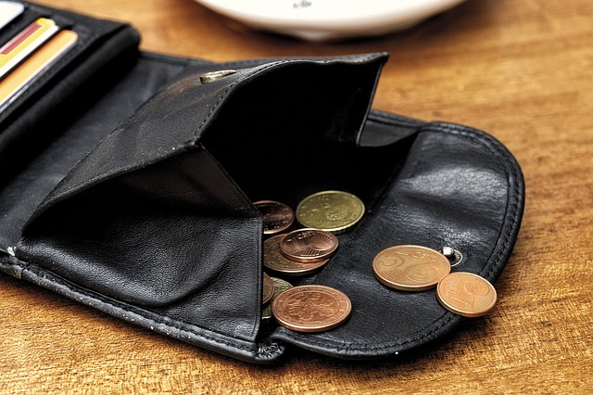
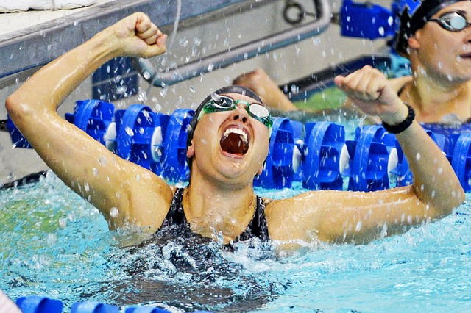
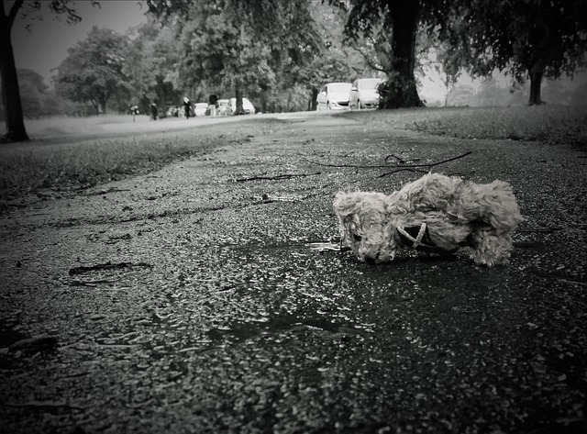
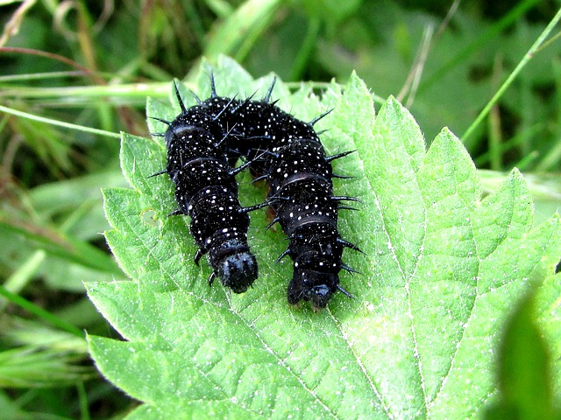
Notes:
Slides 16-17
Using the structure of the “I am” poem in the last slides 13 - 15, learners write their own “I am” poem in the target language.
You may provide images, like these, or a mystery box of objects as inspiration. If studying a text in the target language, learners may write their poems from the perspective of one of the characters. Learners may write their poem from the perspective of a more personal object or person they know.

Slide 17
